Slide 1
Central bank digital currency Threats and vulnerabilities Defcon 29
Ian Vitek CBDC Security
Central bank of Sweden, Sveriges Riksbank

Slide 2
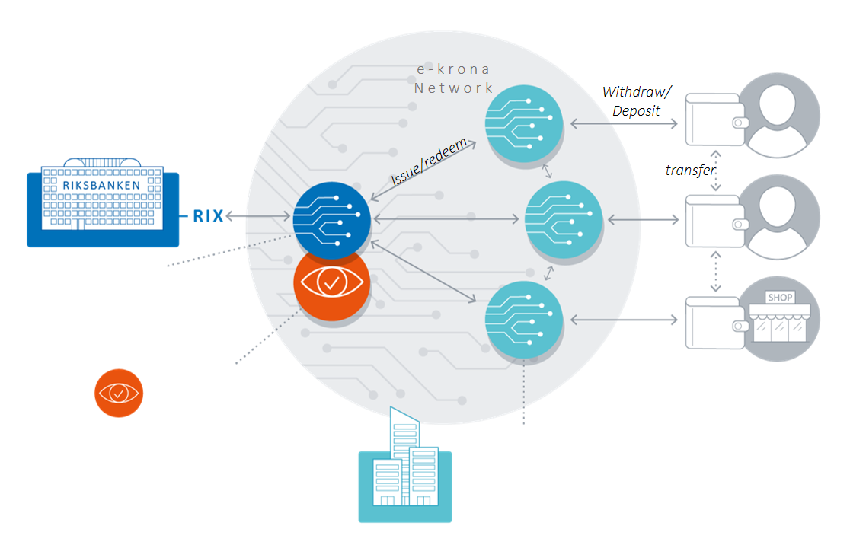
Central bank digital currency Threats and vulnerabilities
Presentation
Background
Detailed system description of the prototype
Vulnerabilities in the retail central bank digital currency prototype
Everything else
Solutions and summary
Notes:
Lots of slides and lots of information. This will go fast so don’t forget to note down interesting slides if you want to go back to actually understand what I said ;)
System components and point out functions that need protection, information to secure and secure communication.

Slide 3


So where do we start?
Ian Vitek
Started with pentests 1996.
Interested in web application security, network layer 2 (the writer of macof), DMA attacks and local pin bypass attacks (found some on iPhone).
Sveriges Riksbank (Central bank of Sweden)
Disclaimer: The views and opinions expressed in this presentation are those of the presenter and do not necessarily represent the views and opinions of the Riksbank.

Slide 4
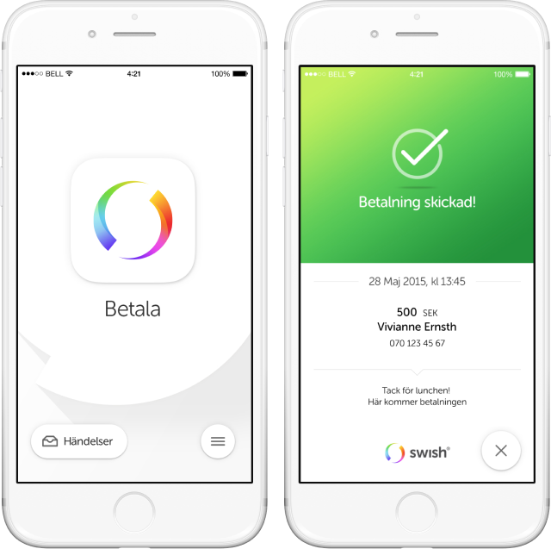

The e-krona project
Why central bank digital currency?
Procurement
Requirements
Winning bid
Work on the prototype phase 1 (year one)
The goal of this presentation is to share insights of the security challenges of building a prototype of a two tier retail central bank digital currency.
Notes:
Commercial banks – Widespread Digital ID and payment service called Swish. Swish is connected to one of your bank accounts and easy person to persons transfers and now payment in many stores.

Slide 5
Detailed system description of the prototype
Security and logic, e.g.
Add and remove alias
Map alias to PSP and wallet
User alias
Logic
DB
Storage of
Alias ⬄ PSP and wallet
Security and logic, e.g.
PIN
Signing transactions
Encryption
PSPn
Corda node
Security and logic, e.g.
Authentication
Push messages, e.g. Firebase
Limits
Back office functions
Security and logic, e.g.
Token transactions
Token verification
Wallet management
PSP3
Corda node
User
PSP1
business logic
PSP1
Corda node
PSP2
Corda node
DB
App
Storage of
PIN
Private key for tokens
Authentication keys
Message keys, e.g. Firebase
DB
Storage of
Public keys (and PSP1 private keys)
Wallets
Tokens
Backchain
Certificates
Storage of
Authentication keys
Payment history
Customer data
Message keys, e.g. Firebase
DB
Disk
DB
DB
Security and logic, e.g.
Issue and redeem
Token verification
Corda network management
Security and logic, e.g.
Prevent double-spends
Sign the transaction
Riksbank
RTGS
Riksbank
business logic
Riksbank
Corda node
Riksbank
Corda notary
Security and logic, e.g.
Interest
Back office functions
Storage of
Notary private key
Hashes of tokens
Certificates
Storage of
Public keys (and Riksbank private keys)
Backchain
Certificates
DB
Storage of
Outstanding CBDC
DB
DB
DB

Slide 6

What is backchain? And how to exploit bad implementation...
Riksbank
Corda node
Issue
PSP1
Corda node
UserA withdraw
PSP1
Corda node
UserA => UserB
PSP2
Corda node
1000
200
50
Transactions
And tokens
Token#: 1[0]
Amount: 1000
Owner: PSP1
Sign: Riksbank
Reference: None
Token#: 2[0]
Amount: 200
Owner: UserA
Sign: PSP1
Reference: 1[0]
Token#: 3[0]
Amount: 50
Owner: UserB
Sign: UserA
Reference: 2[0]
Tx: 1
Tx: 2
Tx: 3
Token#: 2[1]
Amount: 800
Owner: PSP1
Sign: PSP1
Reference: 1[0]
Token#: 3[1]
Amount: 150
Owner: UserA
Sign: UserA
Reference: 2[0]
Notes:
The prototype was built on Corda 4.5 and its Token SDK. Most of the information is simplified and the bugs in the prototype design is verified on Corda 4.7.

Slide 7

How to exploit token selection and long backchains
PSP1 UserA
Historic
Transactions
Withdrawal 3 and deposit 2
Token#1
200
PSP1
Token#2
197
PSP1
Token#3
3
UserA
Token#5
1
UserA
Token#6
2
PSP1

Slide 8
How to exploit token selection and long backchains
PSP1 UserA
Historic
Transactions
So UserA does this over and over again
Token#1
200
PSP1
Token#2
197
PSP1
Token#7
194
PSP1
Token#3
3
UserA
Token#5
1
UserA
Token#8
3
PSP1
Token#9
1
UserA
Token#6
2
PSP1
Token#10
2
PSP1

Slide 9
How to exploit token selection and long backchains
PSP1 UserA
Historic
Transactions
So UserA does this over and over again
Token#1
200
PSP1
Token#7
194
PSP1
Token#3
3
UserA
Token#2
197
PSP1
Token#8
3
PSP1
Token#5
1
UserA
Token#9
1
UserA
Token#6
2
PSP1
Token#10
2
PSP1

Slide 10
How to exploit token selection and long backchains
PSP1 UserA
Historic
Transactions
Many times
Token#1
200
PSP1
Token#x
44
PSP1
Token#3
3
UserA
Token#2
197
PSP1
Token#8
3
PSP1
Token#x
3
PSP1
Token#5
1
UserA
Token#9
1
UserA
Token#x
1
UserA
Token#x
1
UserA
Token#x
1
UserA
Token#x
1
UserA
Token#x
3
PSP1
Token#x
1
UserA
Token#x
1
UserA
Token#x
1
UserA
Token#x
1
UserA
Token#x
1
UserA
Token#x
1
UserA
Token#x
3
PSP1
Token#x
3
PSP1
Token#6
2
PSP1
Token#10
2
PSP1
Token#x
2
PSP1
Token#x
2
PSP1
Token#x
2
PSP1
Token#x
2
PSP1
Token#x
3
PSP1
Token#x
2
PSP1
Token#x
2
PSP1
Token#x
2
PSP1
Token#x
2
PSP1
Token#x
2
PSP1
Token#x
2
PSP1

Slide 11
How to exploit token selection and long backchains
PSP1 UserA
Historic
Transactions
Deposit all tokens
Token#1
200
PSP1
Token#x
44
PSP1
Token#3
3
UserA
Token#2
197
PSP1
Token#8
3
PSP1
Token#x
3
PSP1
Token#5
1
UserA
Token#9
1
UserA
Token#x
1
UserA
Token#x
1
UserA
Token#x
1
UserA
Token#x
1
UserA
Token#x
3
PSP1
Token#x
1
UserA
Token#x
1
UserA
Token#x
1
UserA
Token#x
1
UserA
Token#x
1
UserA
Token#x
1
UserA
Token#n
12
PSP1
Token#x
3
PSP1
Token#x
3
PSP1
Token#6
2
PSP1
Token#10
2
PSP1
Token#x
2
PSP1
Token#x
2
PSP1
Token#x
2
PSP1
Token#x
2
PSP1
Token#x
3
PSP1
Token#x
2
PSP1
Token#x
2
PSP1
Token#x
2
PSP1
Token#x
2
PSP1
Token#x
2
PSP1
Token#x
2
PSP1

Slide 12

How to exploit token selection and long backchains
PSP1 Admin
Redeem
Token#1
200
PSP1
Token#x
44
PSP1
Token#n
12
PSP1
Token#6
2
PSP1
Riksbank Corda node
Token#3
3
UserA
Token#x
2
PSP1
Token#2
197
PSP1
Token#10
2
PSP1
Token#8
3
PSP1
Token#5
1
UserA
Token#x
2
PSP1
Token#x
3
PSP1
Token#x
1
UserA
Token#x
2
PSP1
Token#x
3
PSP1
Token#9
1
UserA
Token#x
1
UserA
Token#x
1
UserA
Token#x
2
PSP1
Token#x
3
PSP1
Token#x
3
PSP1
Token#x
1
UserA
Token#x
1
UserA
Token#x
2
PSP1
Token#x
3
PSP1
Token#x
1
UserA
Token#x
2
PSP1
Token#x
1
UserA
Token#x
2
PSP1
Token#x
1
UserA
Token#x
1
UserA
Token#x
1
UserA
Token#x
2
PSP1
Token#x
2
PSP1
Token#x
2
PSP1

Slide 13
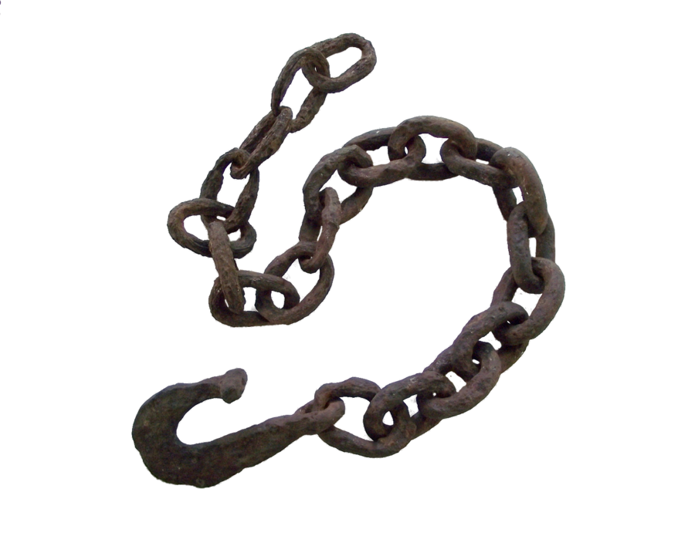
Other setups with better effects
Several issue tokens to get several merkle trees
Split tokens into hundreds
Use hundreds of tokens in one transaction
1
UserB
1500
PSP1
1
UserB
2000
PSP1
100
UserA
1
UserB
5
UserA
1
UserB
And do this over and over again to get the TransactionOfDeath
3000
PSP1
1
UserB
1
UserB

Slide 14

Crash nodes with TransactionOfDeath and permanently lock tokens
Sometimes crashes gives inconsistencies.
Token#1
5
UserA
UserA => UserC
Token#2
5
UserC
PSP1
Corda node
PSP3
Corda node
Available token: Token#1
Mark Token#1 as used
Riksbank
Corda notary
Used token: Token#1

Slide 15
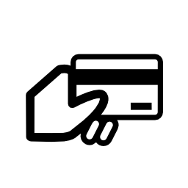

Network problems, timeouts, in memory token selection and lock tokens until restarted
Card payments in the prototype phase 1 is a signed transaction on the smart card traveling through the PSP of the Merchant to card holder PSP.
UserC
PSP1
Corda node
UserC => UserA
PSP3
Corda node
Token#2
5
UserA
Token#1
5
UserC
Timeout!
Available token: Token#1
Error!
Mark Token#1 as used
Riksbank
Corda notary
Used token: Token#1

Slide 16
Evil PSP can lock tokens of other PSPs
As the evil PSP has the information about the tokens sent to others, the evil PSP can send those tokens to the non validating notary node to be marked as used.
EvilPSP
Corda node
UserA => UserC
PSP3
Corda node
Token#1
5
UserA
Token#2
5
UserC
Available token: Token#2
Mark Token#2 as used
Mark Token#1 as used
Riksbank
Corda notary
Used token: Token#1
ing.com https://www.ingwb.com/media/3024436/solutions-for-the-corda-security-and-privacy-trade-off_-whitepaper.pdf
Used token: Token#2

Slide 17
And an ending note on token selection
PSP1 Admin
PSP1 UserA
3500000 not available!
Try Again!
Withdraw 50
Redeem 3500000
Got 50
PSP1 Corda
Token#1
2000000
Owner:
PSP1
Token#2
1000000
Owner:
PSP1
Token#3
1000000
Owner:
PSP1
Token#4
999950
Owner:
PSP1
Token#5
50
Owner:
UserA

Slide 18
Backchain and privacy
To be able to verify authenticity of the tokens all historic transactions for that token is needed.
Riksbank
Corda node
Issue
PSP1
Corda node
UserA withdraw
PSP1
Corda node
UserA => UserB
PSP2
Corda node
1000
200
50
Transactions
And tokens
Token#: 1[0]
Amount: 1000
Owner: PSP1
Sign: Riksbank
Reference: None
Token#: 2[0]
Amount: 200
Owner: UserA
Sign: PSP1
Reference: 1[0]
Token#: 3[0]
Amount: 50
Owner: UserB
Sign: UserA
Reference: 2[0]
Tx: 1
Tx: 2
Tx: 3
Token#: 2[1]
Amount: 800
Owner: PSP1
Sign: PSP1
Reference: 1[0]
Token#: 3[1]
Amount: 150
Owner: UserA
Sign: UserA
Reference: 2[0]

Slide 19
Backchain and privacy
So PSP2 can see how PSP1 have done the issue and how the UserA withdrawn 200.
Issue
PSP1
Corda node
UserA withdraw
PSP1
Corda node
UserA => UserB
PSP2
Corda node
1000
200
50
Token#: 1[0]
Amount: 1000
Owner: PSP1
Sign: Riksbank
Reference: None
Token#: 2[0]
Amount: 200
Owner: UserA
Sign: PSP1
Reference: 1[0]
Token#: 3[0]
Amount: 50
Owner: UserB
Sign: UserA
Reference: 2[0]
Tx: 1
Tx: 2
Tx: 3
Token#: 2[1]
Amount: 800
Owner: PSP1
Sign: PSP1
Reference: 1[0]
Token#: 3[1]
Amount: 150
Owner: UserA
Sign: UserA
Reference: 2[0]

Slide 20
Backchain and privacy
Older and longer backchains reveals more.
Issue
withdraw
UserA
PSP1
UserD
PSP4
PSP1
1000
200
325
50
75
UserG
PSP1
Issue
withdraw
100
PSP2 Admin
UserC
PSP3
PSP3
5000
150
50
UserF
PSP4
UserA
PSP1
UserH
PSP2
100
Issue
withdraw
60
UserE
PSP4
PSP4
20
3000
400
100
UserF
PSP4
UserC
PSP3
50

Slide 21
Practical example: PSP2 backchain
Admin of PSP2 has only information from the PSP2 Corda node and business layer of PSP2.
To be able to get the backchain and to visualize it PSP2 admin has to:
Extract the backchain
Get the transactions
Datamine
Visualize

Slide 22
Practical example: Extract the backchain
Login to PSP2 Corda node and start the Corda node shell.
Run the command
run internalVerifiedTransactionsSnapshot

Slide 23
Practical example: PSP2 backchain
- wire:
id: "6BE4262593EA89C5097FED35221CC0A27FE78F7BB6C10864E4E28269E8F2F038"
inputs:
- txhash: "5C8618DCFB36BFABB0B6DB66331EBEDB3699F50F4AC8FD2EB7291BD782DF5C53"
index: 0
outputs:
- data: !<com.r3.corda.lib.tokens.contracts.states.FungibleToken>
amount: "100.85 SEK issued by Riksbanken"
holder: "aSq9DsNNvGhYxYyqA9wd2eduEAZ5AXWgJTbTGL7RG71TWPEaZJhNFKWZWRp7jCHtRqYdZshmAv1tawKDd55qDnXDFmkUSvMqQhaRdxaMPYinLSop88JwAPReBZJw"
- data: !<com.r3.corda.lib.tokens.contracts.states.FungibleToken>
amount: "5399.15 SEK issued by Riksbanken"
holder: "aSq9DsNNvGhYxYyqA9wd2eduEAZ5AXWgJTbTFUZVr3NjFk7sDNTBjdg3q9sJNbZKfTVhDQ8vcyisu9mWsoMPA1Heqbb3ZbNirZFnBpgkuVDW7yWYsDiBWLGYdmDh"
commands:
- value: !<com.r3.corda.lib.tokens.contracts.commands.MoveTokenCommand>
token:
issuer: "O=Riksbanken, L=Stockholm, C=SE"
tokenType:
tokenIdentifier: "SEK"
inputs:
- 0
outputs:
- 0
- 1
signers:
- "aSq9DsNNvGhYxYyqA9wd2eduEAZ5AXWgJTbTFUZVr3NjFk7sDNTBjdg3q9sJNbZKfTVhDQ8vcyisu9mWsoMPA1Heqbb3ZbNirZFnBpgkuVDW7yWYsDiBWLGYdmDh"

Slide 24
Practical example: Get the transactions
Admin of PSP2 has now extracted and created a JSON list of all transactions for all backchains for all tokens on PSP2 Corda node.
{
"edges": [
{
"source": {"id": "PSP:GfHq2tTVk9z4eXgyKAMEqYfMYACZy4RQAuN3p72MxBywj86qJnnk3EhzaNPr", "label": "PSP:GfHq2tTVk9z4eXgyKAMEqYfMYACZy4RQAuN3p72MxBywj86qJnnk3EhzaNPr"},
"target": {"id": "aSq9DsNNvGhYxYyqA9wd2eduEAZ5AXWgJTbTKnaoNTewVAC9a27PCxXfDoS3pqhMa5duj6jJGEsqpvvtx59oNehuLxgXVWuaJ3oURRezoeTogZjBqpAPFXkmKnC4", "label": "aSq9DsNNvGhYxYyqA9wd2eduEAZ5AXWgJTbTKnaoNTewVAC9a27PCxXfDoS3pqhMa5duj6jJGEsqpvvtx59oNehuLxgXVWuaJ3oURRezoeTogZjBqpAPFXkmKnC4"},
"value": "1337.30"
},
{
"source": {"id": "aSq9DsNNvGhYxYyqA9wd2eduEAZ5AXWgJTbTKnaoNTewVAC9a27PCxXfDoS3pqhMa5duj6jJGEsqpvvtx59oNehuLxgXVWuaJ3oURRezoeTogZjBqpAPFXkmKnC4", "label": "aSq9DsNNvGhYxYyqA9wd2eduEAZ5AXWgJTbTKnaoNTewVAC9a27PCxXfDoS3pqhMa5duj6jJGEsqpvvtx59oNehuLxgXVWuaJ3oURRezoeTogZjBqpAPFXkmKnC4"},
"target": {"id": "aSq9DsNNvGhYxYyqA9wd2eduEAZ5AXWgJTbTJX1eBDU2mve7qqDWbmoVu9HDG1pstQnSss4TsEC68tDuWKSRZ9hNJDrmcfkxZ4agpD7qM2UsvAGcPWwbG3qdAuts", "label": "aSq9DsNNvGhYxYyqA9wd2eduEAZ5AXWgJTbTJX1eBDU2mve7qqDWbmoVu9HDG1pstQnSss4TsEC68tDuWKSRZ9hNJDrmcfkxZ4agpD7qM2UsvAGcPWwbG3qdAuts"},
"value": "1337.40"
}]
}

Slide 25
Practical example: Datamine
Admin of PSP2 has the public keys of users in the backchain but can enrich the information with wallet ID or alias with information in the logs or from user transaction log in the PSP2 business layer. To be able to do this any user on PSP2 must have done a transaction with that public key earlier.
User history record extract from PSP2 business layer.
TxID | 0DDB759E02091B3A52D61194AE7D464F7022DBF3DBAF45005B74F27F0E49A0B7
Command | PAY
Payer wallet ID | 9021f73d-d883-4cfb-8899-203690bff93f
Payer PSP | PSP1
Payee wallet ID | cf960d62-b1a6-4816-8179-717808d160d8
Payee PSP | PSP2
Amount | 5.00

Slide 26
Practical example: Visualize
Just pour the enriched JSON transaction list into HTML with D3.js (https://d3js.org/) function d3.layout.force() to connect all the transactions.
<script>
d3.json("back2.json", function(error, data) {
...
var force = d3.layout.force();
...
graph = new myGraph();
graph.initialize();
</script>

Slide 27
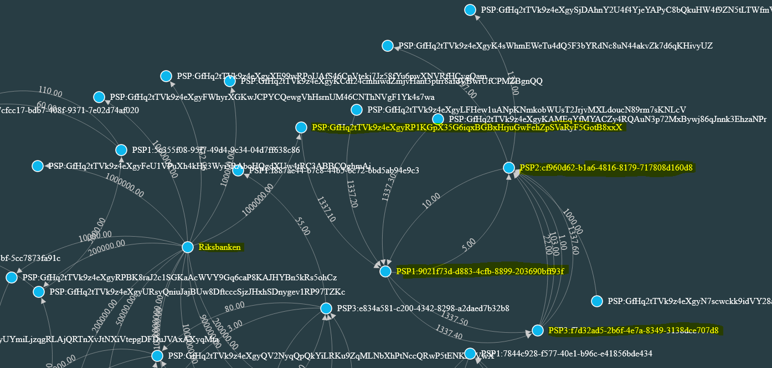
Visualization with data only from PSP2

Slide 28
Backchain and privacy
Need to be compliant with:
European General Data Protection Regulation (GDPR)
Swedish bank secrecy regulation

Slide 29
Everything else
Everything that must be solved before going in production with a token based retail CBDC
Performance and authenticity of the digital currency.
High availability and in memory token selection.
Catastrophic failures and disaster recovery.
A secure offline?
Non-repudiation.
Information security (ISO 27000)
IT security (NIST, OWASP)
Laws, regulations and financial compliance
Notes:
Many tokens and long backchains, 24/7 service and service, restore backup and missing transactions, secure design of offline, authorization, not missing anything regarding information security (access control, operation security, incident management) including IT security and compliance.

Slide 30
Solutions
There are many solutions for the presented challenges.
Chain snipping, Chipping, Key rotation, Zero knowledge proof and other encryption.
Validating notary node.
Hardware wallets (e.g. smart cards).
Restore procedures and functions for correcting inconsistencies.
The Riksbank is now experimenting with other designs and will also look at other technologies.

Slide 31
Summary
The goal of this presentation is to share insights of the security challenges of building a prototype of a two tier retail central bank digital currency based on a blockchain with value based tokens.
Only presented threats, vulnerabilities, security fails and some unknowns.
Not presented the good design and all the positive lessons learned!

Slide 32
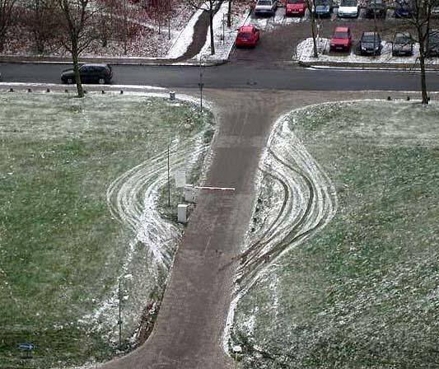
Thank you for attending

